Slide 1
Characterization of mutational processes affecting metastatic transformation in melanoma and the impact on therapy effectiveness
Doan Trang Laura Vo Ngoc
23 August, 2018

Slide 2
Background

Slide 3
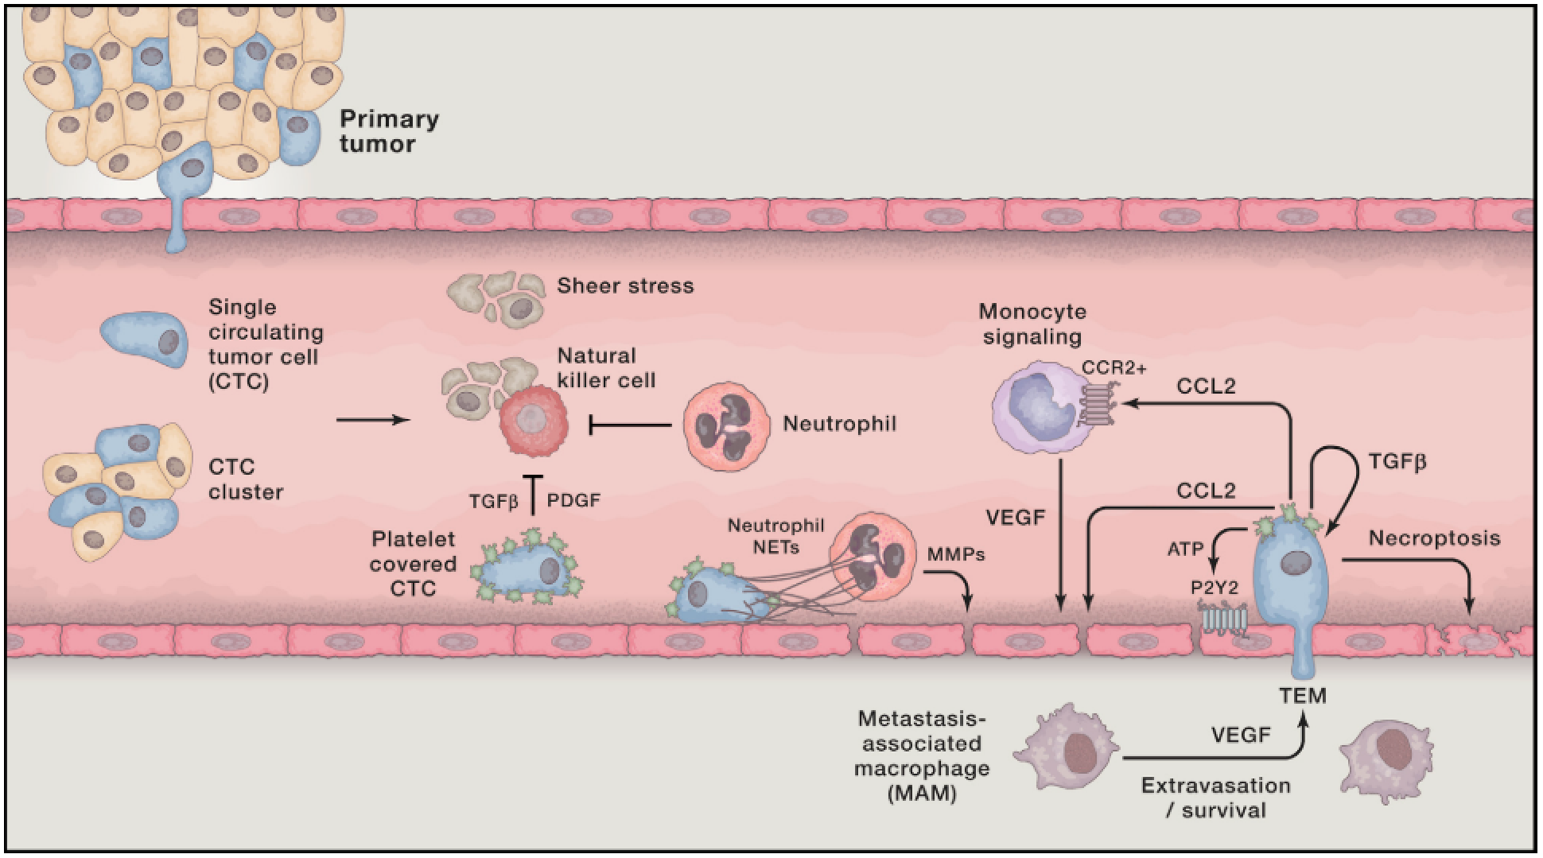
Metastasis
Leading cause of death
Seeding from primary tumor
Immune recruitment and metastatic niche formation
Colonization
(Lambert, 2017)

Slide 4
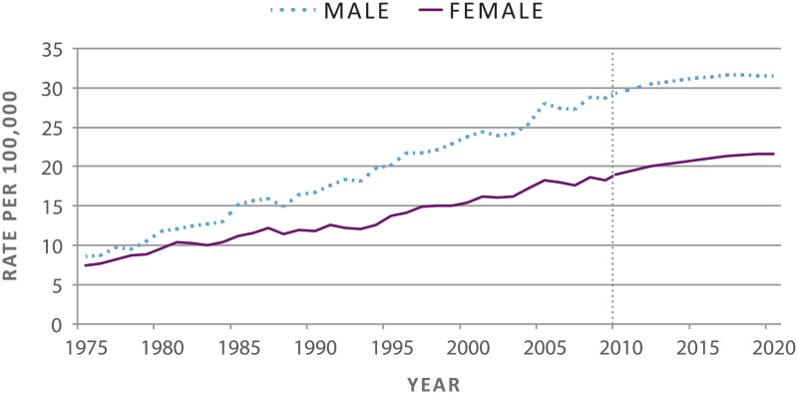
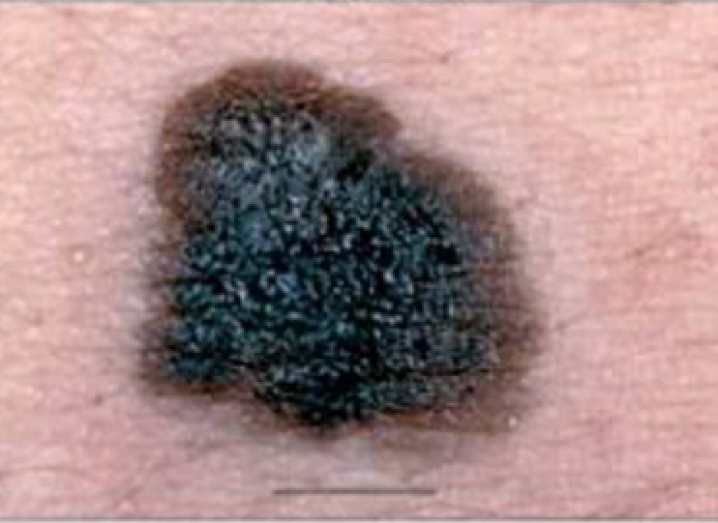
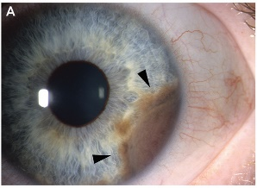
Melanoma
Rising incidence
Subtypes
Acral, mucosal, uveal, cutaneous
5-year survival
Primary: 99%
Metastatic: 49%
Pathways involved in:
Cell growth
Survival
Proliferation
Cutaneous
Uveal
(US Department of Health and Human Services, 2014; Arrangoiz et al., 2016)

Slide 5
Melanoma
Rising incidence
Subtypes
Acral, mucosal, uveal, cutaneous
5-year survival
Primary: 99%
Metastatic: 49%
Pathways involved in:
Cell growth
Survival
Proliferation
Therapies
Surgery
Chemotherapy
Radiotherapy
Targeted therapies
Immune-checkpoint therapies
(Lo and Fisher, 2014)
Notes:
Immune-checkpoint → block disease’s immune system inhibitors → allow immune system to attack tumor

Slide 6
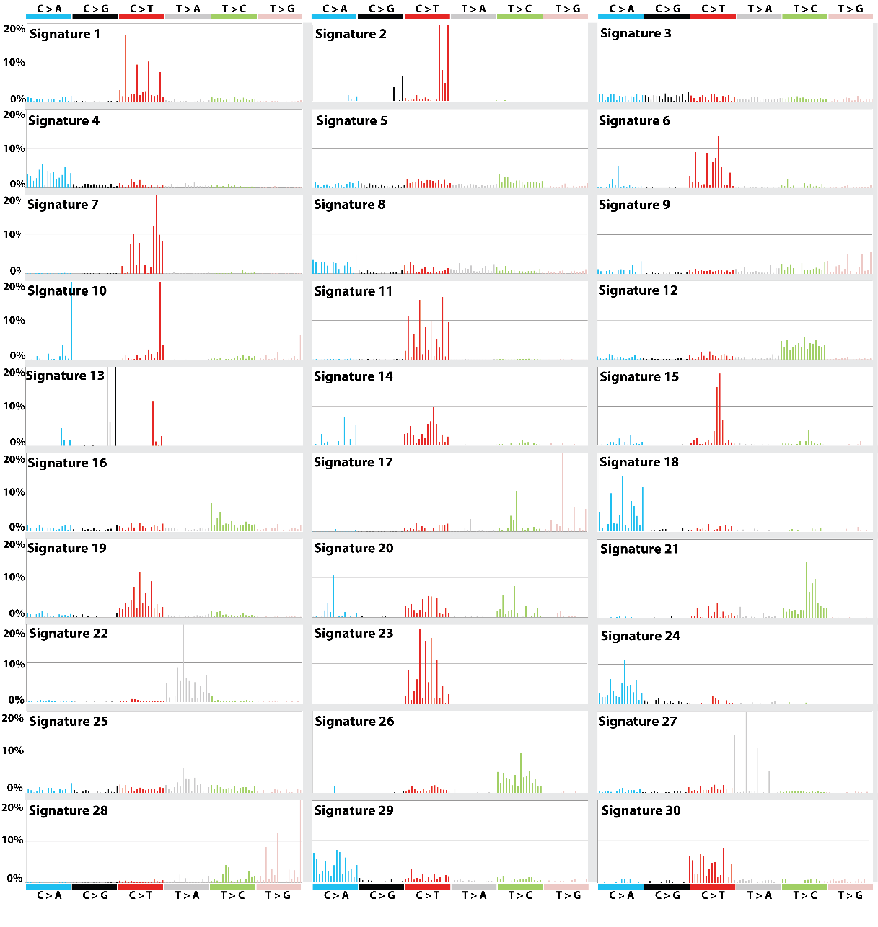
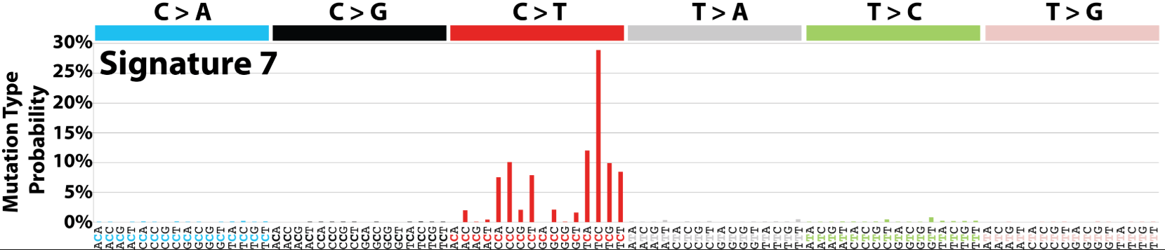
Mutational signatures
Context-specific somatic mutations
Two adjacent bases are important
Example: T[C]C > T[T]C
Associated to risk factors
COSMIC https://cancer.sanger.ac.uk/cosmic/signatures
UV LIGHT EXPOSURE
(Forbes et al., 2018)

Slide 7
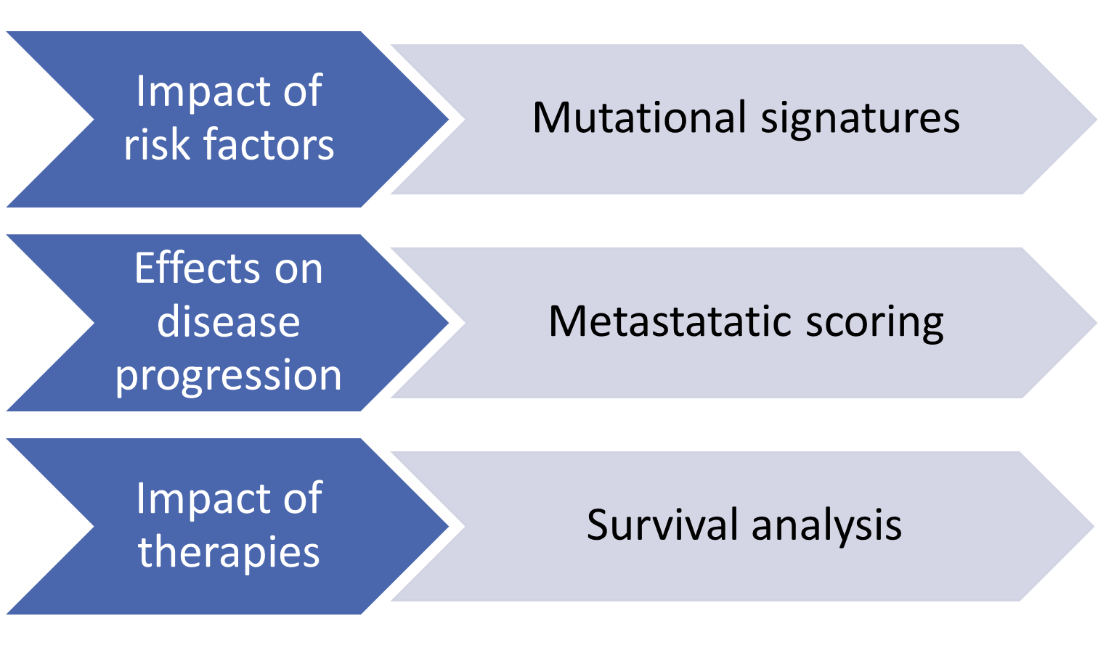
Aims & methods overview

Slide 8



Methods
The Cancer Genome Atlas (TCGA)
Whole exome sequencing
Clinical data
Gene expression data
Two cohorts
Skin cutaneous melanoma (SKCM)
Uveal melanoma (UVM)
Validation dataset – International Cancer Genome Consortium (ICGC)
Whole genome sequencing
Two cohorts
Australian melanoma (MELA-AU)
Brazilian skin adenocarcinoma (SKCA-BR)
Analyzed using R packages specific for these data

Slide 9
Metastatic scoring
$$\text{Metastatic} \text{potential} \text{score}= \frac{\text{Avg} \text{expression} \text{upregulated} \text{genes}}{\text{Avg} \text{expression} \text{downregulated} \text{genes}}$$

Slide 10
Results

Slide 11
Mutational signatures

Slide 12
Top 5 contributors
Sample | Signatures | Etiology
SKCM | S7 | UV light exposure
 | S1 | Aging
 | S11 | Alkylating agents
 | S23 | Unknown; strong transcriptional strand bias
 | S6 | Defective DNA mismatch repair
UVM | S1 | Aging
 | S22 | Aristolochic acid
 | S15 | Defective DNA mismatch repair
 | S3 | DNA double-strand break repair failure
 | S6 | Defective DNA mismatch repair

Slide 13
METASTATIC SCORING

Slide 14
Metastatic score correlates (primary SKCM)
Signature 1
Correlation coefficient = 0.16
p = 0.10
Signature contributions
Signature 7
Correlation coefficient = 0.14
p = 0.17

Slide 15
Metastatic score correlates (primary SKCM)
Signature 1
Correlation coefficient = 0.43
p = 0.03
Signature contributions
Signatures 1 and 7 in BRAF WT
Signature 7
Correlation coefficient = 0.46
p = 0.02

Slide 16
Metastatic score correlates (primary SKCM)
Signature 1
Correlation coefficient = 0.41
p = 0.82
Signature contributions
Signatures 1 and 7 in BRAF WT
Signatures in BRAF mutant
Signature 7
Correlation coefficient = 0.11
p = 0.57

Slide 17
Metastatic score correlates (all samples)
Signature contributions
Signatures 1 and 7 in BRAF WT
Signatures in BRAF mutant
Schwann cell marker genes expression
Primary SKCM
Correlation coefficient = 0.26
p = 0.05
Metastatic SKCM
Correlation coefficient = 0.13
p = 0.002
Primary UVM
Correlation coefficient = 0.19
p = 0.04

Slide 18
Metastatic potential vs. survival
Primary UVM
PRIMARY SKCM

Slide 19
Univariate survival models
Primary SKCM
METASTATIC SKCM

Slide 20
Multivariate survival models
+ risk of death
Improved survival
Not statistically significant
Risk of death

Slide 21
NER / MMR
Nuclotide excision repair (NER) | Mismatch repair (MMR) | Others with transcriptional strand bias
S4 | S6 | S2
S7 | S15 | S5
S11 | S20 | S12
S22 | S26 | S23
S24 |  | S27
S25
Marker genes expression
Correlates with metastatic potential score
Few correlations with signatures in TCGA cohorts

Slide 22
Survival models in combined cohort
Disease progression
Cohort

Slide 23
Survival models in combined cohort
Disease progression

Slide 24
Without treatment
+ risk of death
Improved survival
Not statistically significant
Risk of death

Slide 25
With treatment
+ risk of death
Improved survival
Not statistically significant
Risk of death

Slide 26
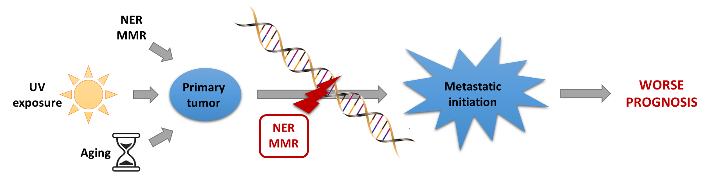
Conclusion

Slide 27
Some limitations
TCGA limitations
Small sample size
Lack of matched samples
No matched control data
Non-uniform and missing clinical annotations
Whole exome sequencing
ICGC lack of expression data
TCGA and ICGC data differences

Slide 28
Future research
Replication in larger cohorts
Better clinical data annotation
Uniformalized data acquisition methods
More complete survival annotation
Metastatic scoring in SKCM with more specific marker genes
Comparison with new mutational signatures (Alexandrov et al., 2018)
Chromosomal instability
Comparison with cancer in other tissues

Slide 29
References
Alexandrov LB, Nik-Zainal S, Wedge DC, et al. Signatures of mutational processes in human cancer. Nature. 2013;500(7463):415-421.
Arrangoiz R. Melanoma Review: Epidemiology, Risk Factors, Diagnosis and Staging. J Cancer Treat Res. 2016;4(1):1.
Forbes SA, Bindal N, Bamford S, et al. COSMIC : mining complete cancer genomes in the Catalogue of Somatic Mutations in Cancer. 2018;39(October 2010):945-950.
Lambert AW, Pattabiraman DR, Weinberg RA. Emerging Biological Principles of Metastasis. Cell. 2017;168(4):670-691.
Lo, J.A., Fisher, D.E., 2014. The melanoma revolution: From UV carcinogenesis to a new era in therapeutics. Science (80-. ). 346, 945–949. https://doi.org/10.1126/science.1253735
Sandru A, Voinea S, Panaitescu E, Blidaru A. Survival rates of patients with metastatic malignant melanoma. J Med Life. 2014;7(4):572-576.
US Department of Health and Human Services, 2014. Figure 3, Age-Adjusted Melanoma Incidence Rates, Actual and Projected, by Sex, 1975–2020, in: The Surgeon General’s Call to Action to Prevent Skin Cancer. Office of the Surgeon General (US), Washington (DC).

